Slide 1

Welcome to Cub Scouts
Cub Scouts is where ADVENTURE meets FUN and FRIENDS!

Slide 2
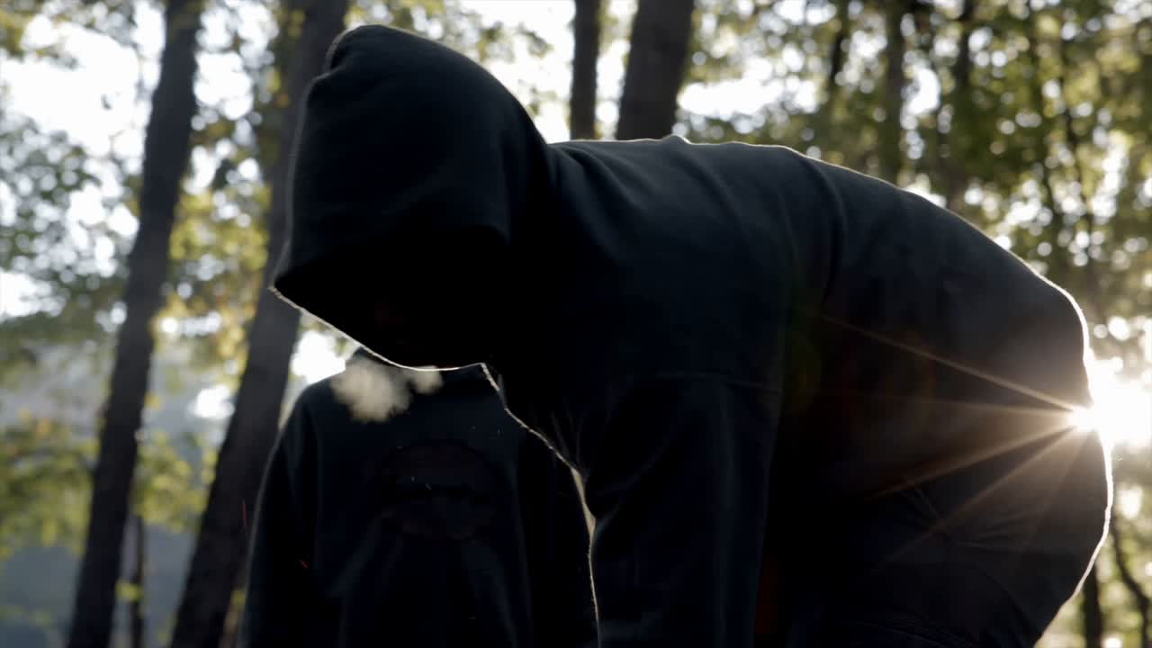


Slide 3
What is Cub Scouting?
A
program
for boys & girls in grades k-5
family

Slide 4
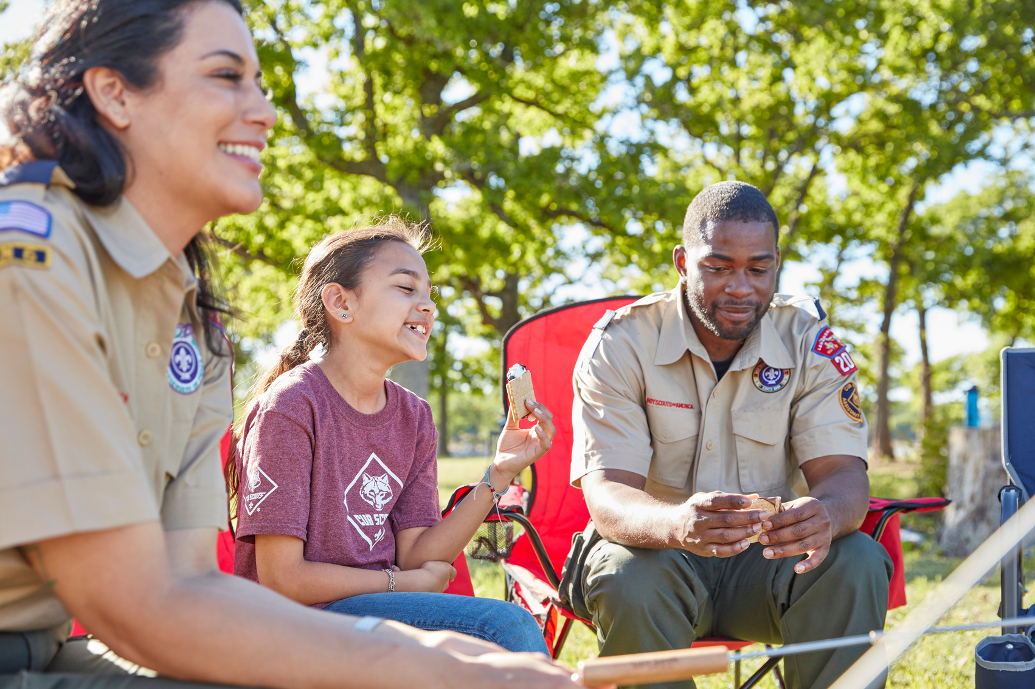
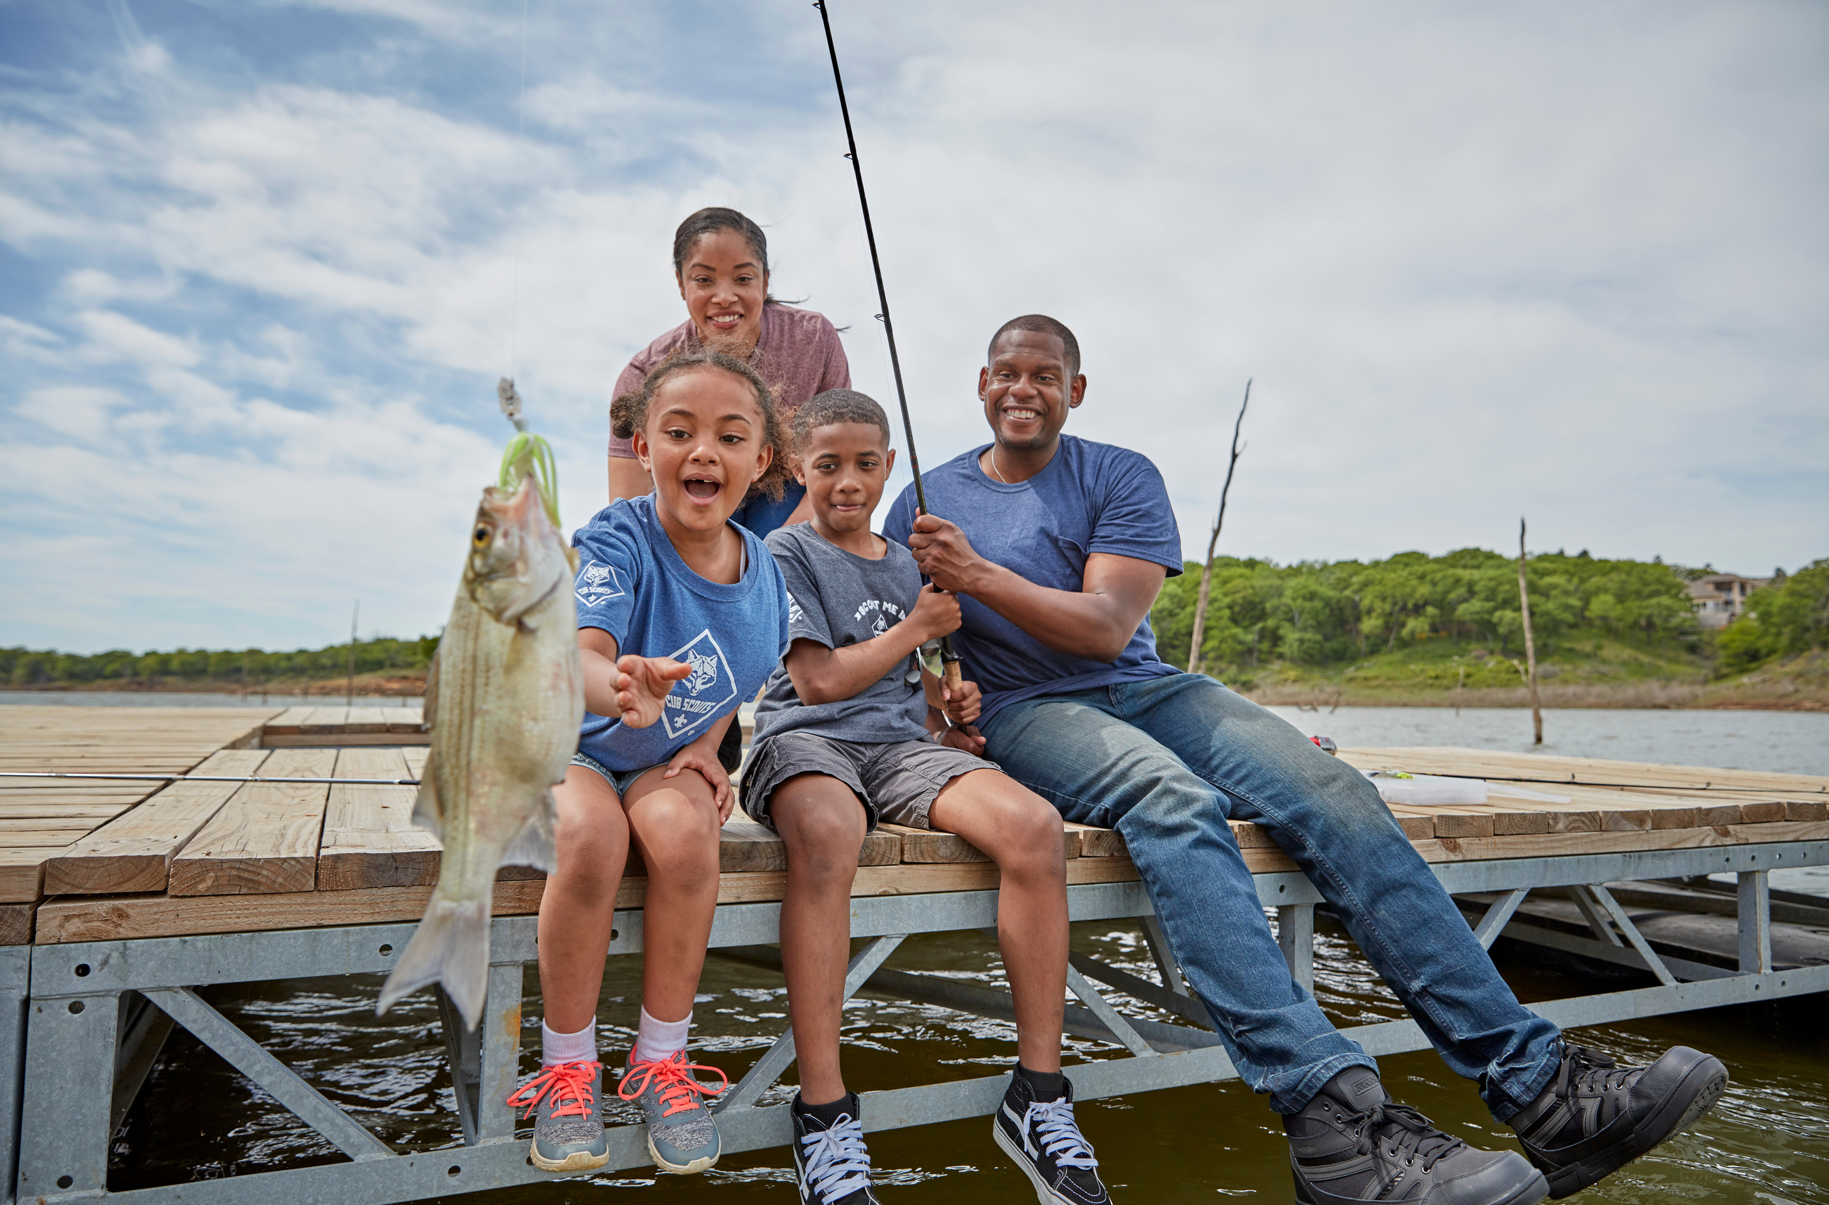
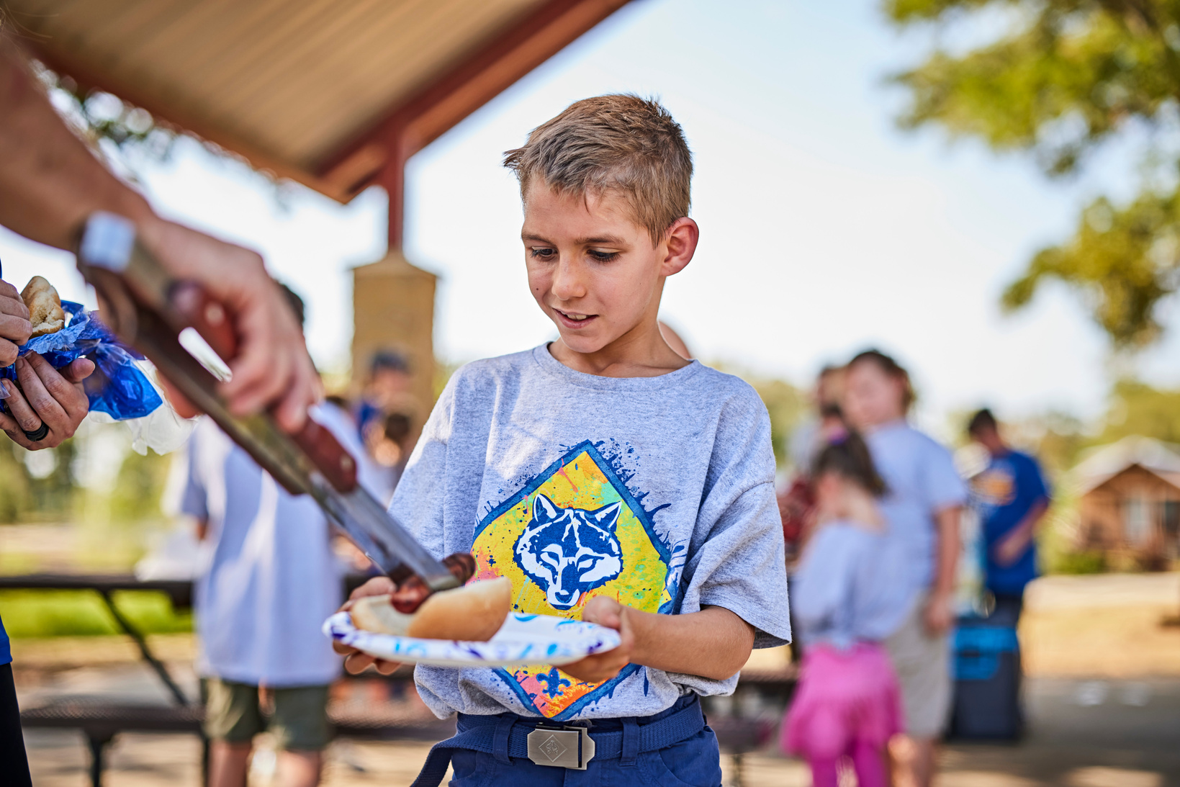
Imagine a world where curious minds explore the wilderness, build forts, and learn to be kind, respectful, and helpful—traits that shape boys and girls into the leaders of tomorrow.

Slide 5
What do parent’s want?
  Children who flourish and respect family values.
  Children who are successful and have great self-esteem.
  Children master new skills and meet new people.
  and of course, have
fun

Slide 6

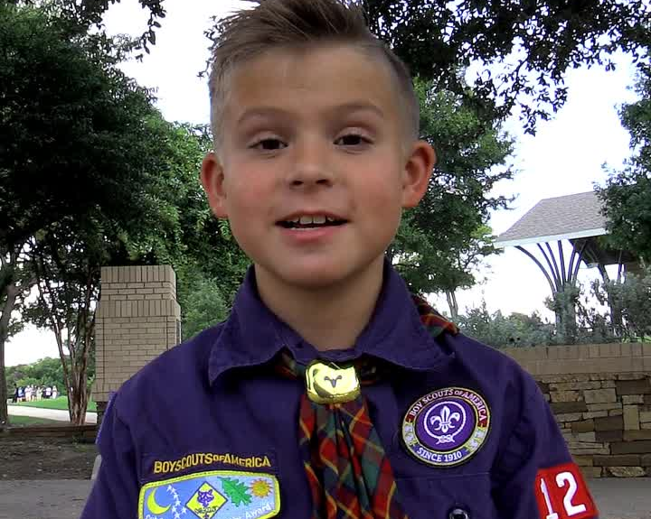
What do kids want?
fun
Here it from one of our scouts

Slide 7
Cub Scouting is:
Character Building
Citizenship Training
Personal Fitness
and
fun

Slide 8
Cub Scouts have:
Meetings
Activities
Advancements
and
fun

Slide 9
Meetings
Den Meetings are small groups, usually grouped by age or grade.
Pack Meetings consist of the entire group of scouts.

Slide 10
Activities
Camping in the Spring and Fall
Day Camp during School breaks
Pinewood Derby
Blue & Gold Banquet
Webelos Adventure Camp
Cub Overnighter
and so much more!

Slide 11
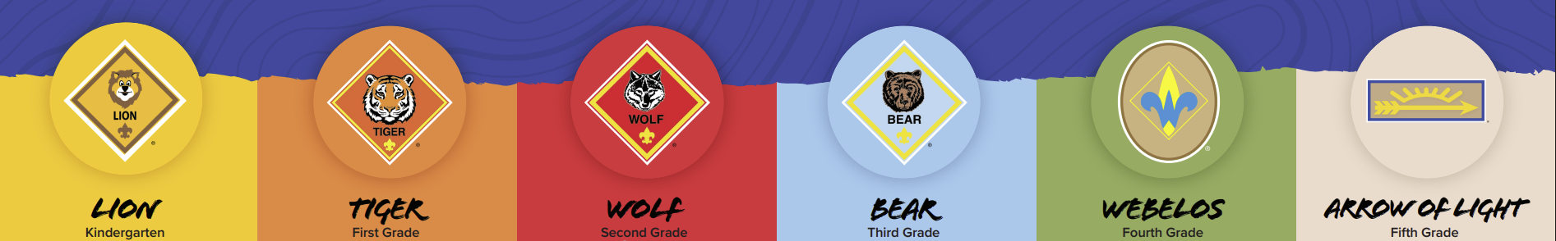
Advancements

Slide 12
Advancements
All Kindergartners join a Lion Den.
Lion Cubs all have an adult who serves as the Lion’s partner.

Slide 13
Advancements
All 1st Graders join a Tiger Cub Den.
Tiger Cubs all have an adult who serves as the Tiger’s partner.

Slide 14
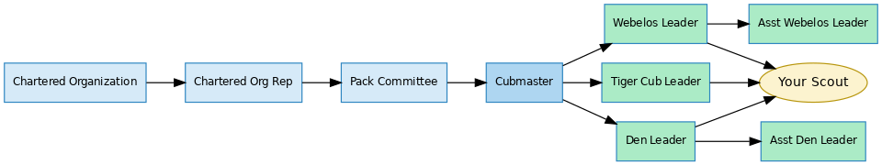
Your cub is part of a Pack
and a Den
Which is supported by our District Committee and Commissioner Staff as well as our Council office.

Slide 15
Support
Monthly Roundtables
Den & Pack Meeting Resource Guide
Leader Specific Training
Youth Protection Training
Online Training
Scouting Magazine
Scouts’ Life Magazine
Commissioner Service

Slide 16
Cost
Registration
Scouts’ Life Magazine
Handbook
Uniform ( New & Used when available)
Dues
Family & Friends of Scouting

Slide 17




What’s next

Slide 18




What’s next
Me, a Leader?
Ready or Not, we’ve got you covered with impeccable training programs

Slide 19
Why?
For Your Kid!
These are the key years to help develop & influence your child.
Notes:
Look at this yardstick as you child’s life. Each ½ inch equals 1 year of his life. 36 inches - 72 years, the average person's lifespan. At 1/2" (1 year) he is cruising the carpet and furniture, getting into all kinds of things he shouldn't. At 3” he's six and is in first grade, and excited about school. At 5-1/2" he's eleven, and is moving on to Jr. High or Middle School. At 9" he's eighteen and graduating High School. You're busting your buttons with pride for him in his cap and gown. At 11" he's graduating from college and has moved on to his own life and family.
I'd like to go back to the 2" between 3" and 5" (between 6 and 10 years old).
These 2,3, or 4 years are key years in your child's development. Many of their decision-making skills, ethics and morals will be developed and reinforced during this time. A recent study showed that young people who were close to a caring adult in these early years were less likely to get into trouble with drugs, crime, etc. and were more likely to continue in school. These five years are the years of the Cub Scout. Lions through Arrow of Light.
In Cub Scouting we need every family to get involved this much.[refer to the distance between your fingers]. "This much" is different for everybody. Your "This much" might be as a committee member, or a den leader for your child; or for others', it might be organizing an outing, handling the Pack treasury, writing a newsletter, organizing the Blue and Gold banquet. It might even be as a Cubmaster.

Slide 20
In Cub Scouts, friendships are forged, memories are etched, and character blossoms like a wildflower. It’s more than just an after-school activity; it’s a journey of laughter, growth, and endless possibilities. Let the adventure begin.

Slide 21
Questions?

Slide 22
Cub Scouts®. Do Your Best. Have Fun Doing It.

