Slide 1
Be sure to delete the placement guides before downloading pdf file for printer.
The inner blue dotted line is the “safe zone” for your content.

Slide 2


Hi Neighbor! My name is ______________ from local Scout Unit ________. I’m fundraising to support local Scouting programs and activities. You can help by purchasing our delicious popcorn online at popcornordering.com. You will help us out, won’t you?

Slide 3
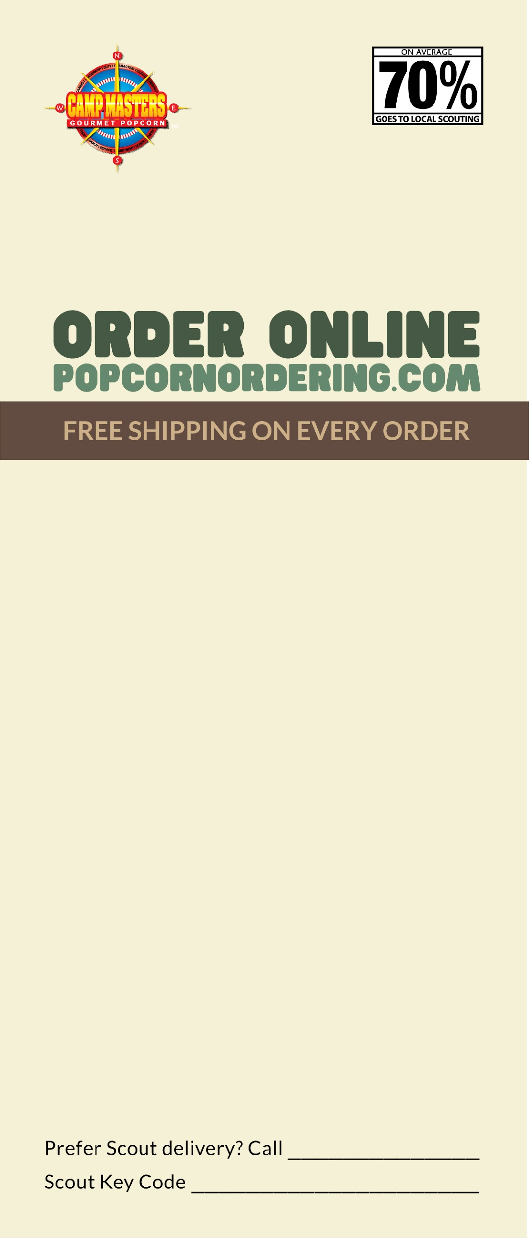

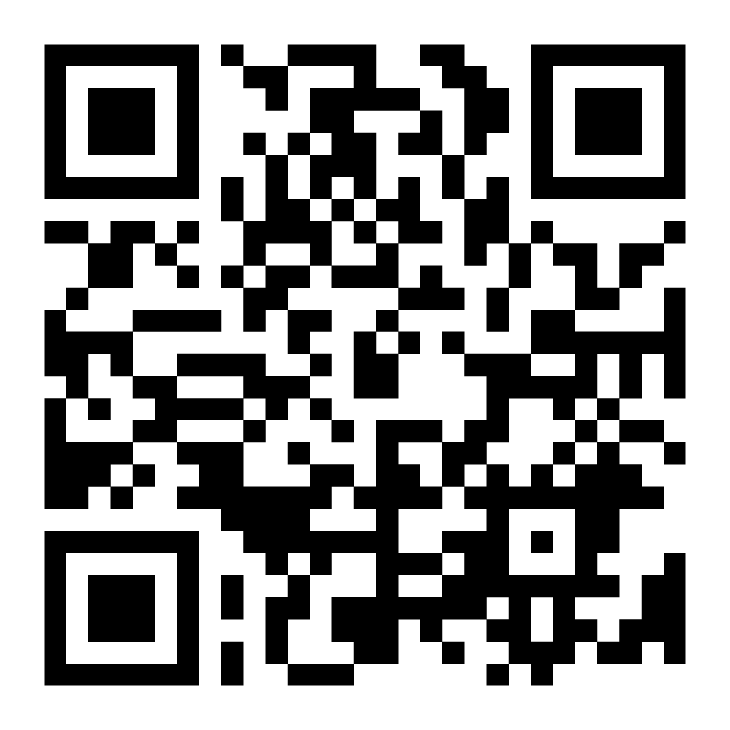
Insert Product name & images here.

